Slide 1

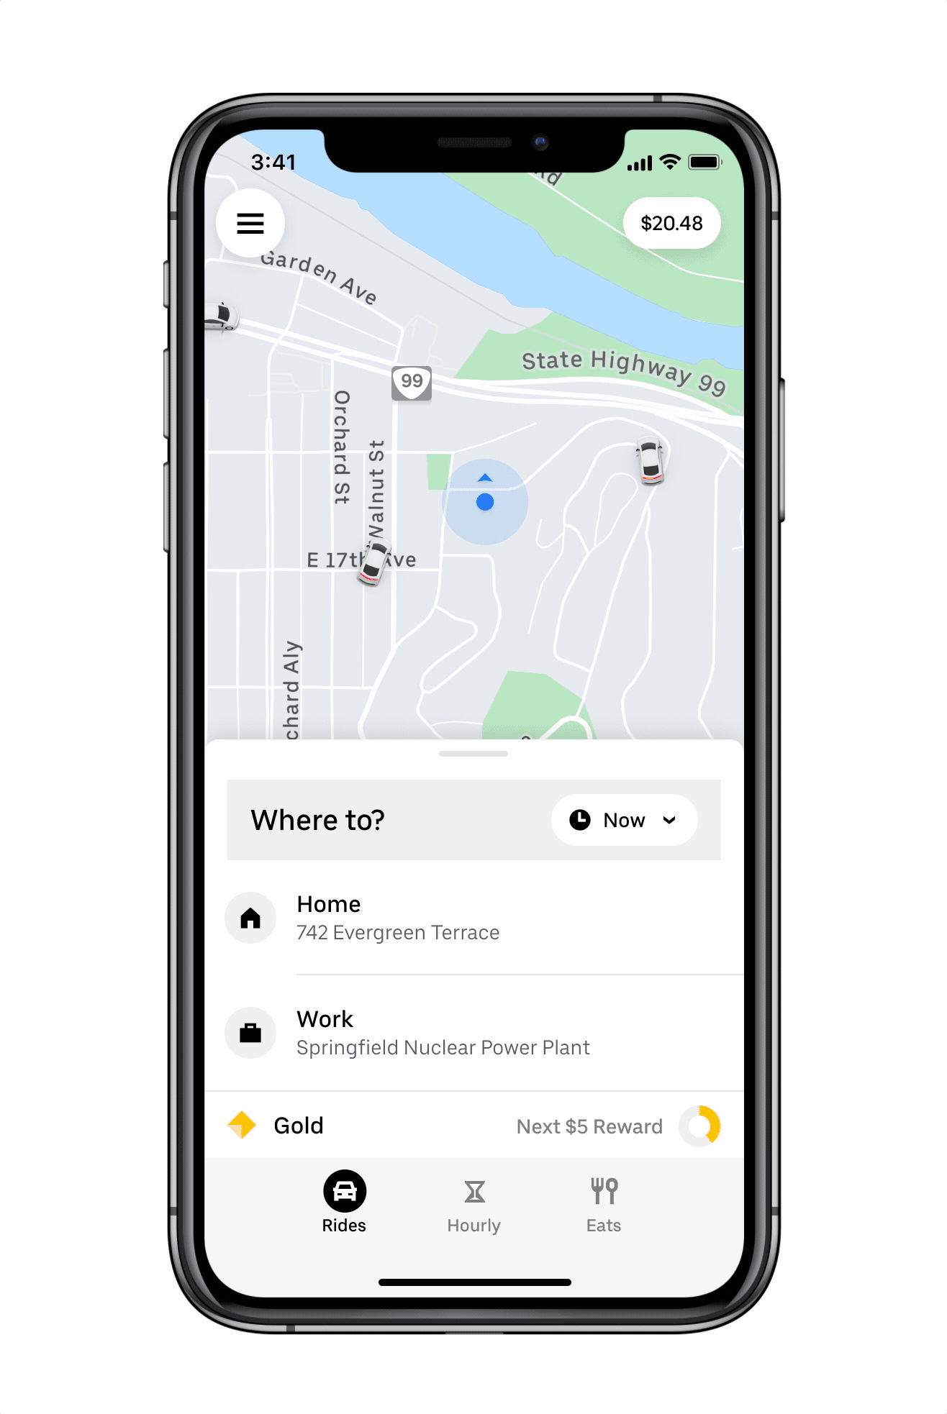

Uber Data Analysis
Under The Guidance of
Sudhakara Upadya P
Reg. Number | Name | Branch
201046017 | Divya G B | BDA
201046018 | Bhanuprakash S | BDA

Slide 2
What is Uber?
INTRODUCTION
Uber is an American international transportation network company.
Uber is on-demand car service. It provides a new way for passenger to request the private drivers through smart phone application.
The internet-based taxi-hailing services like Uber are growing by leaps and bounds.

Slide 3
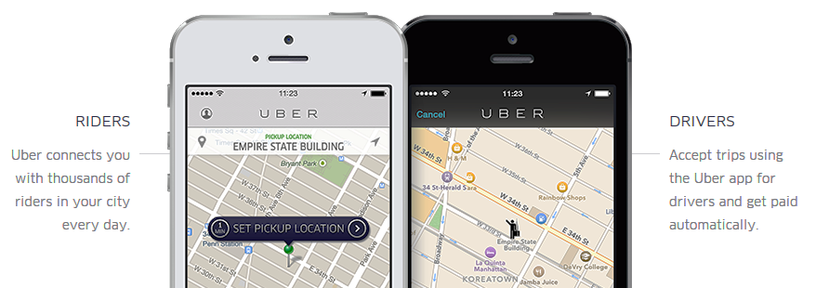
Uber

Slide 4
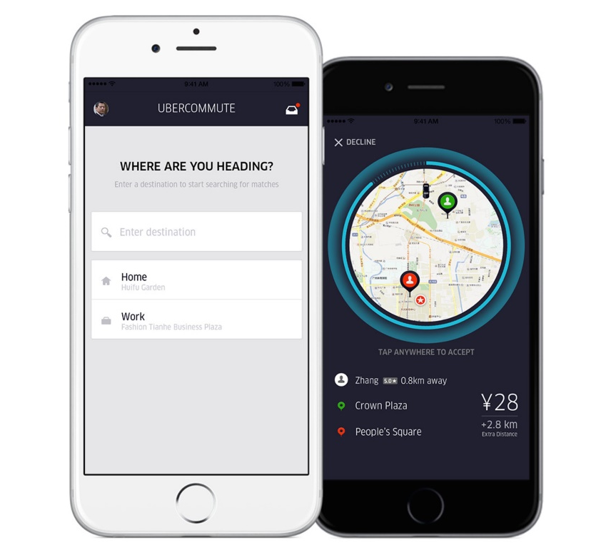
Branding Strategy
Personalized service
Easy to use
(thru smart phone app)
Better quality
(ratings & feedback)
Reliable
(arrival on time)
Fare auto deduct by phone app
Comfortable interior
Convenient of pickup

Slide 5
How to use it?
First, tap to set your pickup location.
Request your ride and a driver will accept.
Enter the address or name of your destination.
After pickup, uber shows the driver where they are going.
It will show you the route and estimated time of arrival(ETA).

Slide 6
Uber Data
Uber stores data for every trip taken in the background, even when the driver has no passengers. Uber uses our data in an anonymized and aggregated form to closely monitor which features of the Service are used most frequently, to analyze usage patterns, and to determine where it should offer or focus its Service.

Slide 7
Problems Faced by Uber Drivers
When we looked up what uber drivers care about on the internet, we discovered that they are sometimes unsure where to go when they don't have passengers, that of course would cause lots of waste of time and money.

Slide 8
Advantages of Uber Data Analysis
Saves Fuel
Time saving
Increase profit for uber drivers
Quick Access for uber users

Slide 9

Methodology
UBER – Users and Driver application
CSV – Uber data fetched using Uber Application
Google Map – To analyze and display uber pick-up and drop-off location using Maps
Jupyter - Tool used for uber data analysis
Figure: Uber Data Analysis Method.

Slide 10
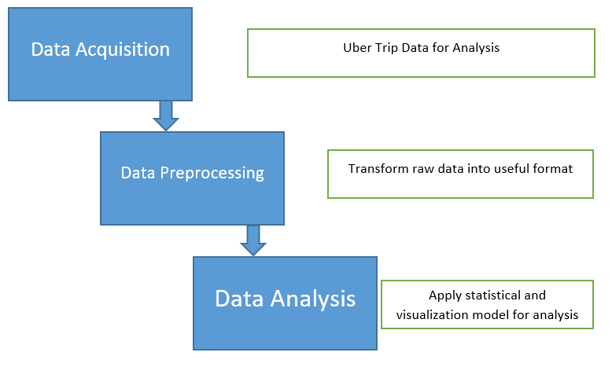
Methodology
Figure: Flow Diagram of the Uber data analysis

Slide 11
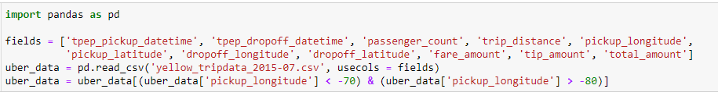
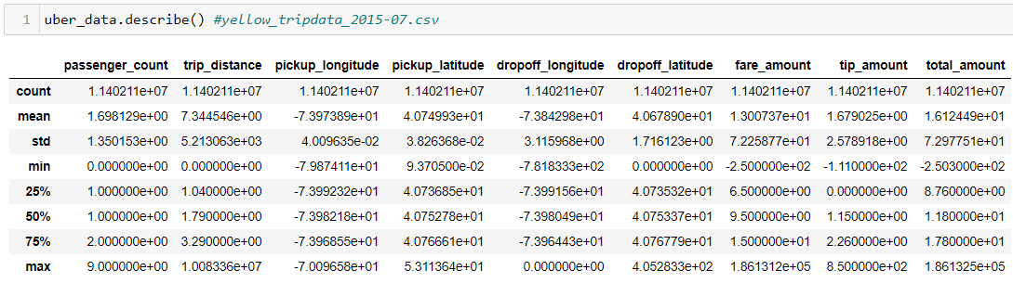
Uber Data Analysis
Data Collection/Processing:

Slide 12
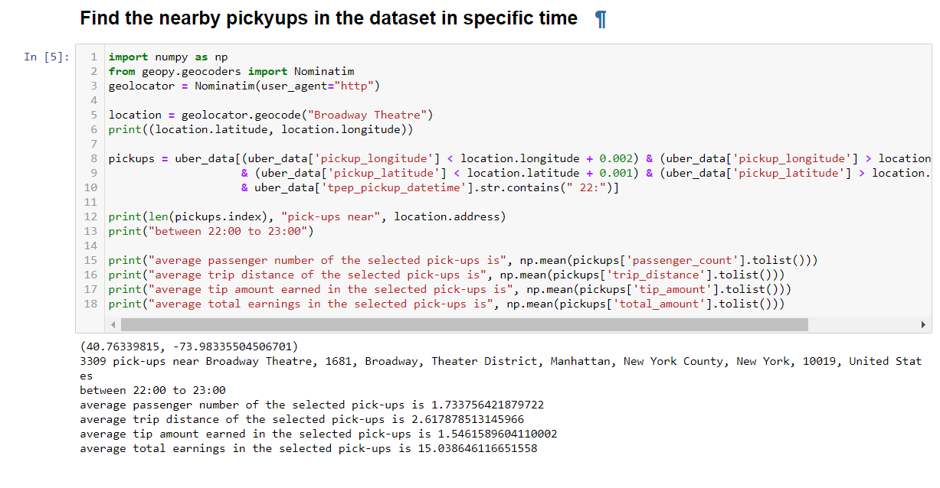
Uber Data Analysis
Finding the nearby pickups

Slide 13
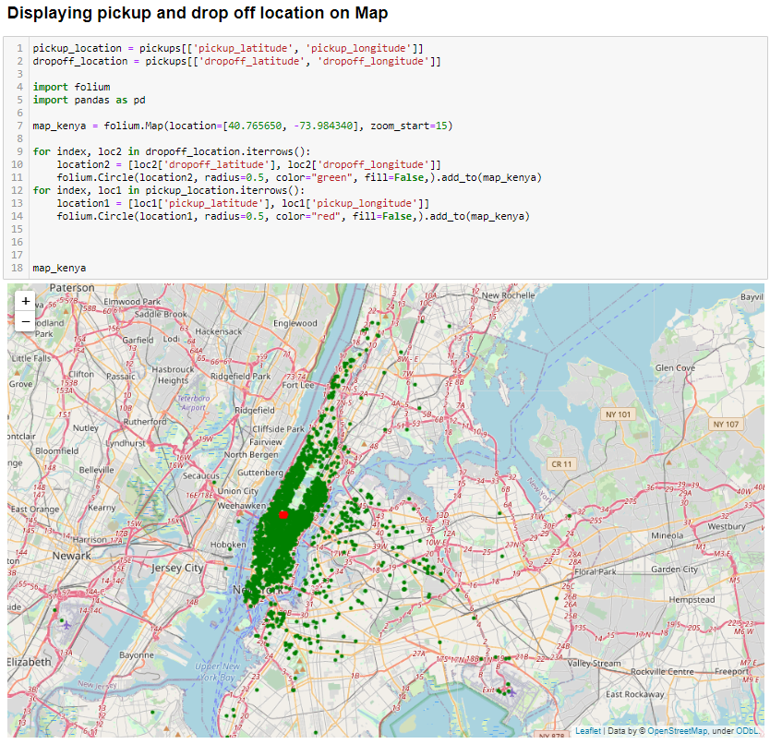
Uber Data Analysis
Displaying pickup and drop off location on Map

Slide 14
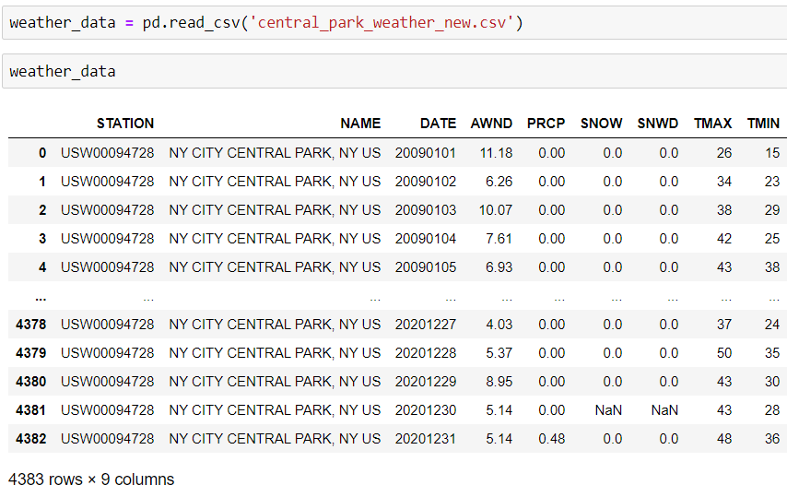
Central Park Weather Dataset
We compare a little bit analysis to check weather as a potential factor influencing Uber needs
PRCP = Precipitation (tenths of mm)
AWND = Wind Speed (mph)
SNOW = Snowfall (mm)
SNWD = Snow depth (mm)
TMAX = Maximum temperature (tenths of degrees C)
TMIN = Minimum temperature (tenths of degrees C)

Slide 15
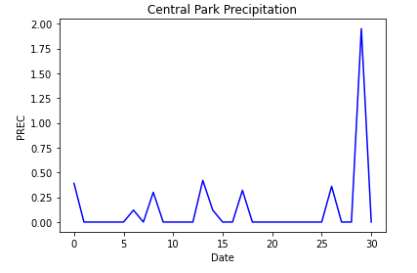
Precipitation
Precipitation is low in the beginning of the month, from the 1st to the 25th of July 2015, but it is high from the 26th of July until the end of the month.

Slide 16
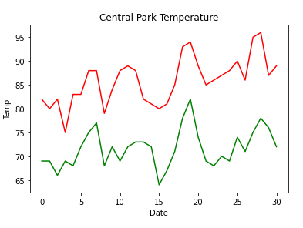
Central Park Temperature.
RED: TMAX = Maximum temperature (tenths of degrees C)
GREEN: TMIN = Minimum temperature (tenths of degrees C)

Slide 17
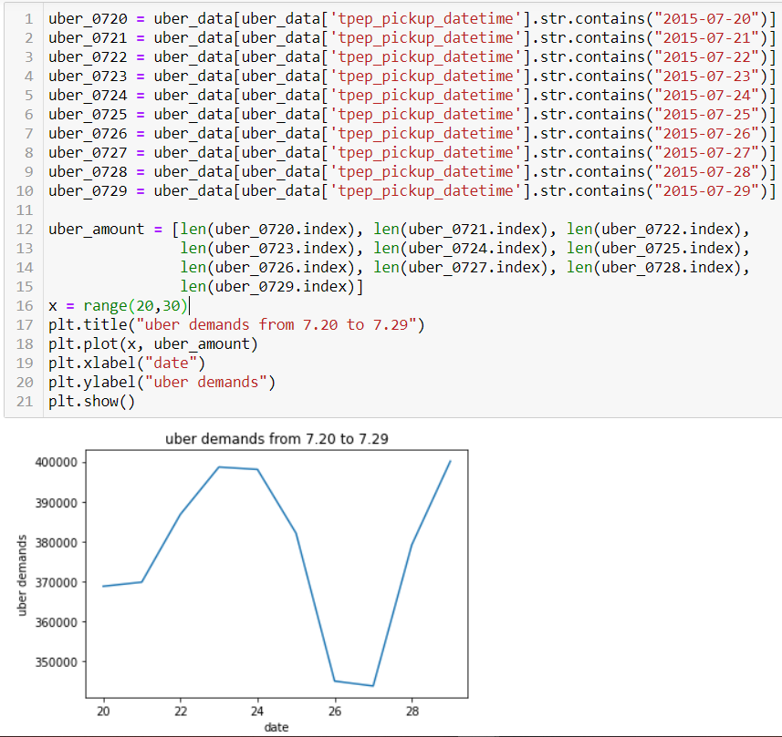
Uber Demand
Increasing and decreasing Uber Demands from 20th July to 29th July

Slide 18
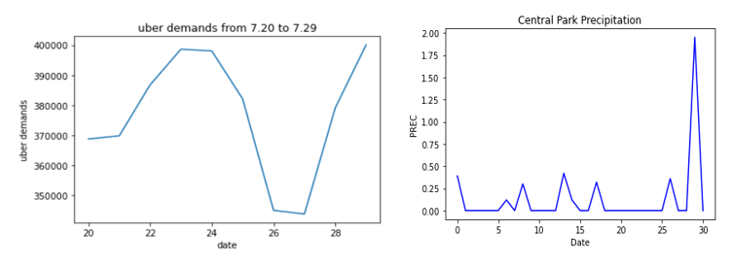
Comparing Uber Demand and Weather Precipitation

Slide 19
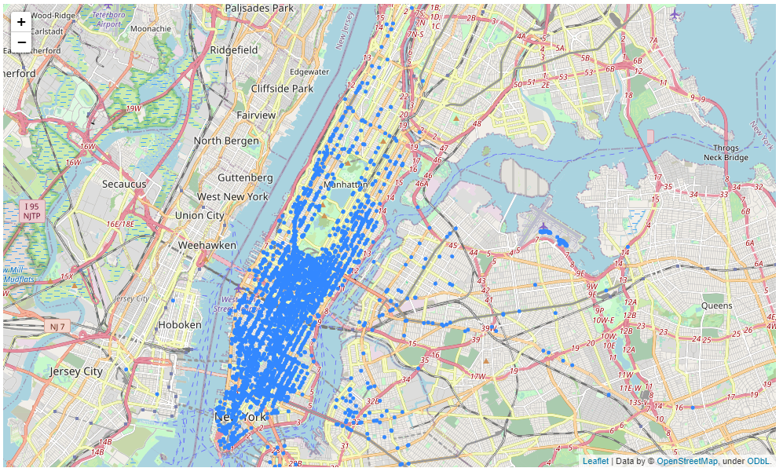
Pickup location of 29th July 2015.
Uber Pickup Locations New York City

Slide 20
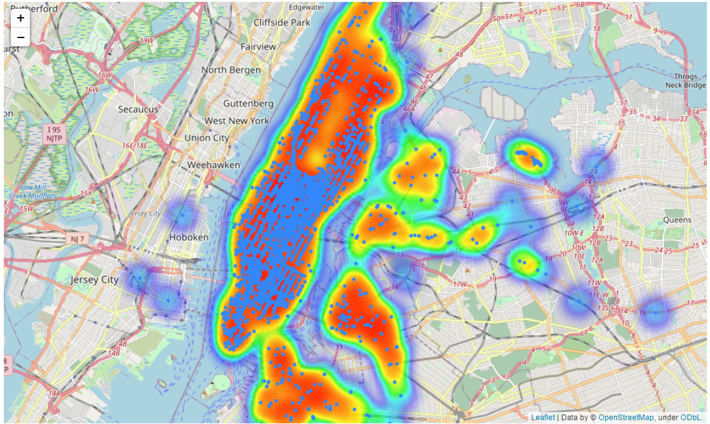
Heat Map of Uber Pickup locations.
Uber Pickup Locations New York City

Slide 21
Conclusion
Uber Data Analysis helps the uber driver to be aware of what they should do and where they should go, as well as the average fare, trip distance, tip amount earned, total earnings and time spent on rides. We also compared weather data analysis to Uber demand analysis to see if the weather has an impact on Uber rides/demands.

Slide 22
References
https://www1.nyc.gov/site/tlc/about/tlc-trip-record-data.page
https://www.weather.gov/okx/CentralParkHistorical
https://towardsdatascience.com/exploratory-data-analysis-eda-a-pratical-approach-using-your-uber-rides-dataset-5e9f0e892149
https://www.kaggle.com/theoddwaffle/uber-data-analysis
https://www.uber.com/in/en/careers/teams/data-science/

Slide 23
Thank You

